Slide 1
Use Case: Integrated Asset & Experiment Analytics Database
Charlotte Sy

Slide 2
Background & Business Problem
Background/Business Problem:
EAM systems track assets (maintenance, status, location)
ELN/LIMS systems track experiments and samples
Systems are separate → data is siloed
Difficult to track asset usage in experiments
Limited cross-functional analysis
Solution:
Design an integrated analytics database
Combine asset (EAM) and experiment (ELN/LIMS) data
Improve traceability between assets and experiments
Support maintenance and compliance analysis
Enable cross-departmental reporting

Slide 3
Business Requirements
Track experiments, assets, samples, and maintenance
Link assets to experiments (usage tracking)
Track maintenance history and compliance
Support department and location analysis
Enable identification of past-due maintenance usage

Slide 4
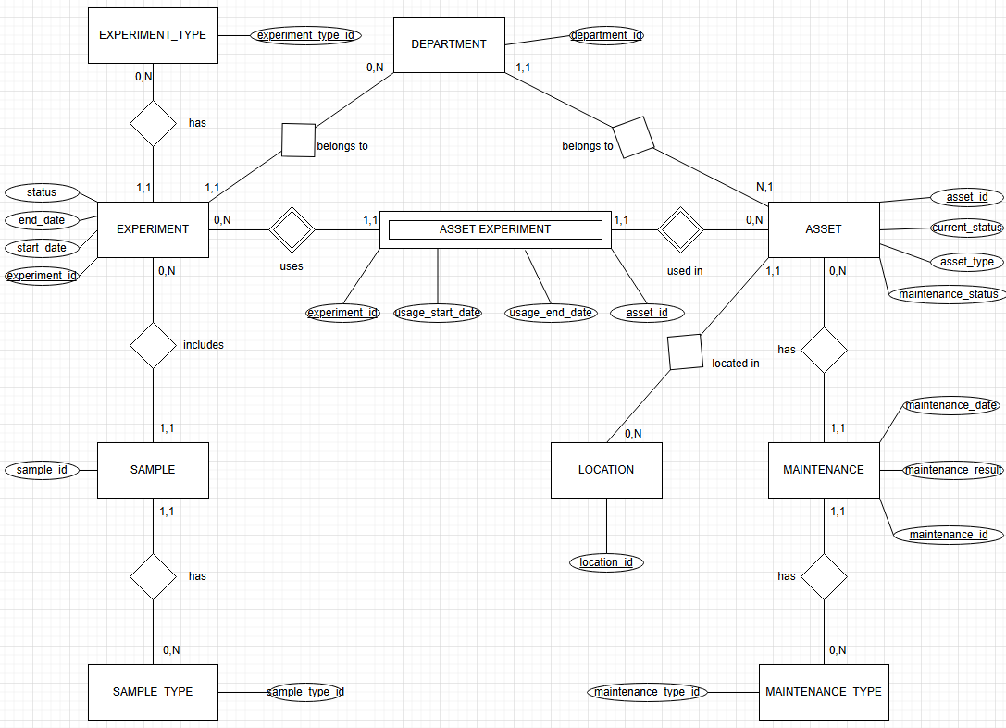
Conceptual Model
EER Model

Slide 5
Relational Model
10 tables
Main:
Experiment( experiment_id, experiment_type_id, department_id, experiment_start_date, experiment_end_date, experiment_status )
Asset( asset_id, asset_type, asset_current_status, asset_maintenance_status, department_id, location_id )
Maintenance( maintenance_id, maintenance_type_id, maintenance_date, maintenance_result, asset_id )
Sample( sample_id, sample_type_id, experiment_id )
Asset_Experiment( experiment_id, asset_id, usage_start_date, usage_end_date )
Reference:
Department( department_id )
Location( location_id )
Experiment_Type( experiment_type_id )
Sample_Type( sample_type_id )
Maintenance_Type( maintenance_type_id )
Foreign keys enforce relationships
Associative table resolves M:N
Normalized no redundancy

